Slide 1
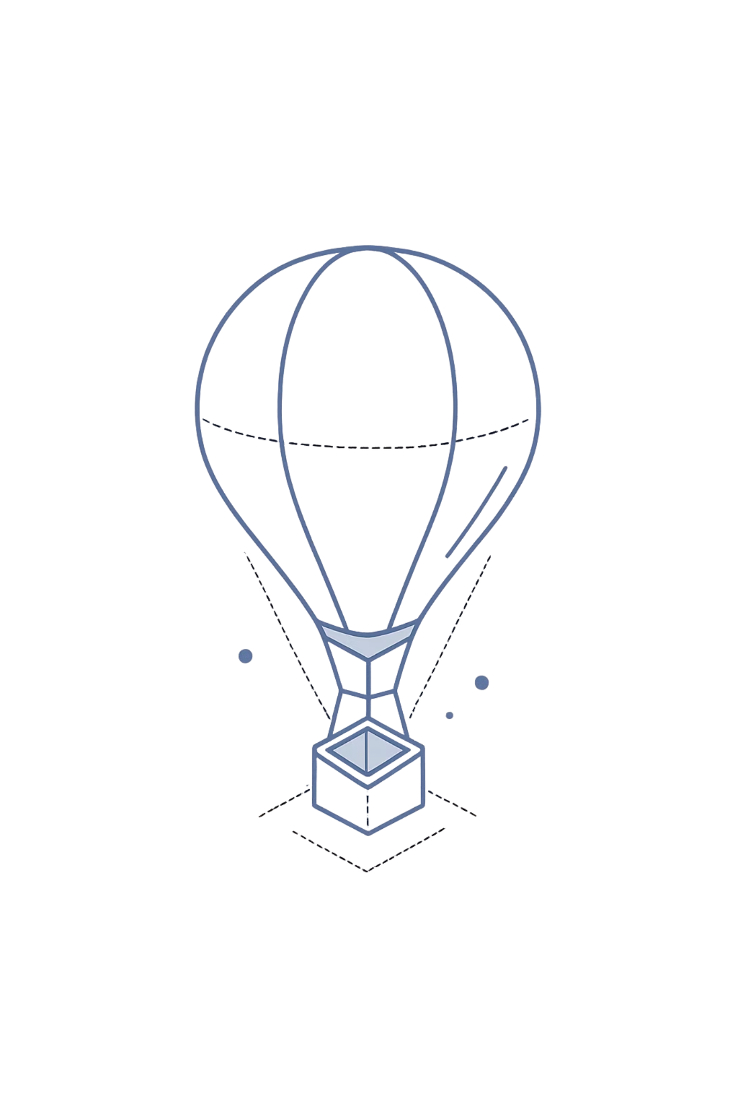
Advanced React Development
MODULE 2 · DAY 2
A hands-on, 6-hour deep dive into dynamic UIs, multi-page routing, and real-world API integration — everything you need to build production-ready React applications.

Slide 2


Conditional Rendering & Dynamic Lists
Conditional Rendering
Lists & Keys
Control what the UI shows based on state and props using &&, ternary operators, and early returns. Avoid rendering stale or irrelevant UI.
Render collections efficiently with .map(). Use stable, unique key props to help React reconcile the virtual DOM without unnecessary re-renders.
Keys must be stable and unique among siblings — avoid using array index as a key in dynamic lists.

Slide 3
Forms Handling & Validation
1
2
3
Controlled Components
Validation Strategies
Error Feedback
Bind every input to state via value + onChange. React owns the source of truth for all form data.
Validate on blur, on change, or on submit. Use inline logic or libraries like Yup for schema-based rules.
Display contextual error messages tied to each field. Keep UX smooth — surface errors without disrupting the user's flow.
Lab goal: Build a multi-field form with real-time validation and conditional submit behaviour.

Slide 4
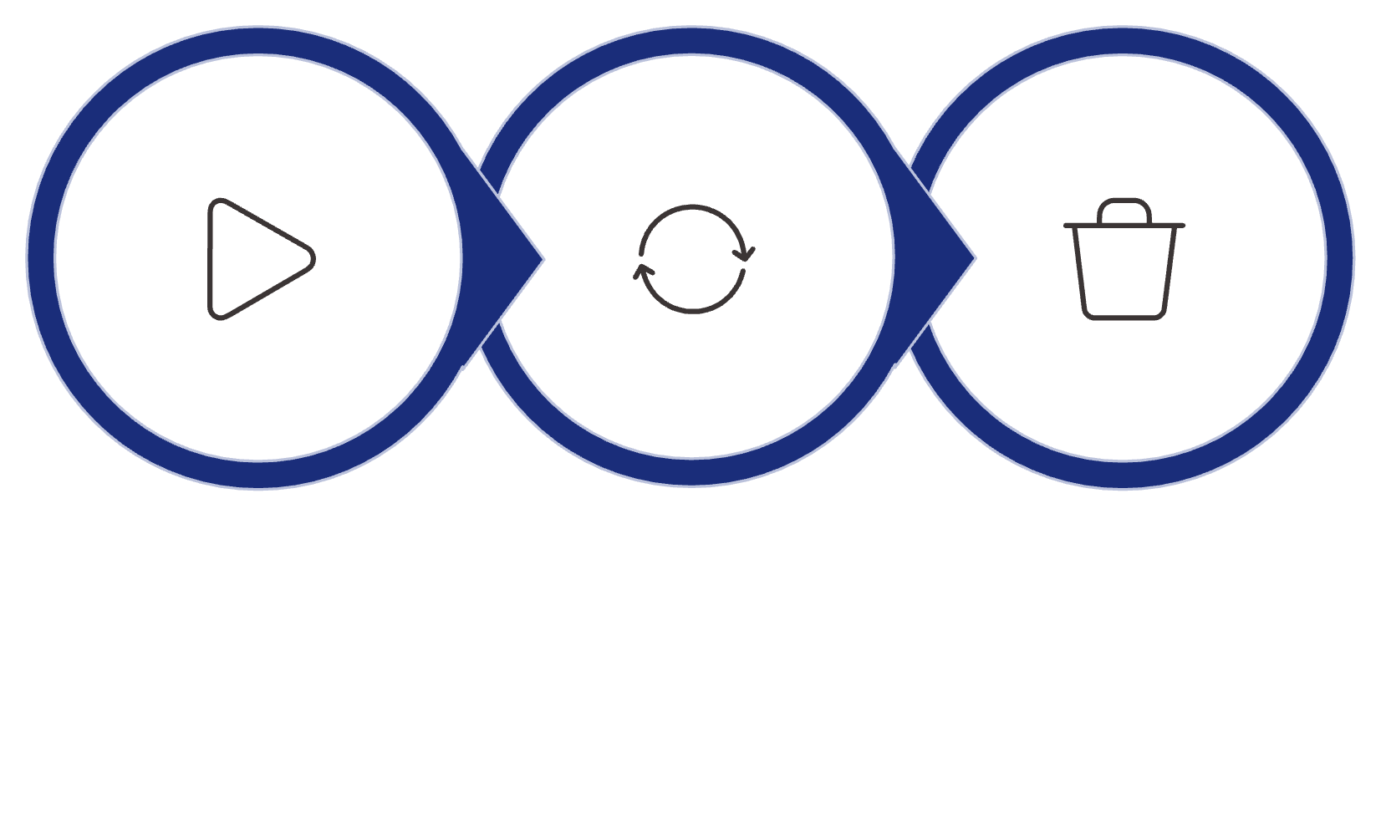

Component Lifecycle & Hooks
Essential Hooks
useEffect
Run side effects after render. Return a cleanup function to prevent leaks on unmount.
useRef
Persist values across renders without triggering re-renders. Great for DOM access.
Mount
Update
Unmount
useCallback / useMemo
Understanding the lifecycle helps you control side effects, prevent memory leaks, and optimise rendering behaviour.
Memoize functions and computed values to avoid unnecessary child re-renders.

Slide 5

React Event System & Passing Arguments
Synthetic Events
Passing Arguments
React wraps native browser events in a cross-browser SyntheticEvent. Access e.target, e.preventDefault(), and e.stopPropagation() reliably across environments.
Use arrow functions or .bind() to pass extra data to handlers: onClick={() => handleDelete(id)}. Avoid creating new functions in render loops.
Event Delegation
React attaches a single root listener rather than per-element listeners. This makes large lists highly performant with minimal memory overhead.

Slide 6

CHAPTER 2
React Router + Data Handling
Move beyond single-page views — learn to structure multi-page React applications with clean, declarative routing and dynamic navigation patterns.

Slide 7
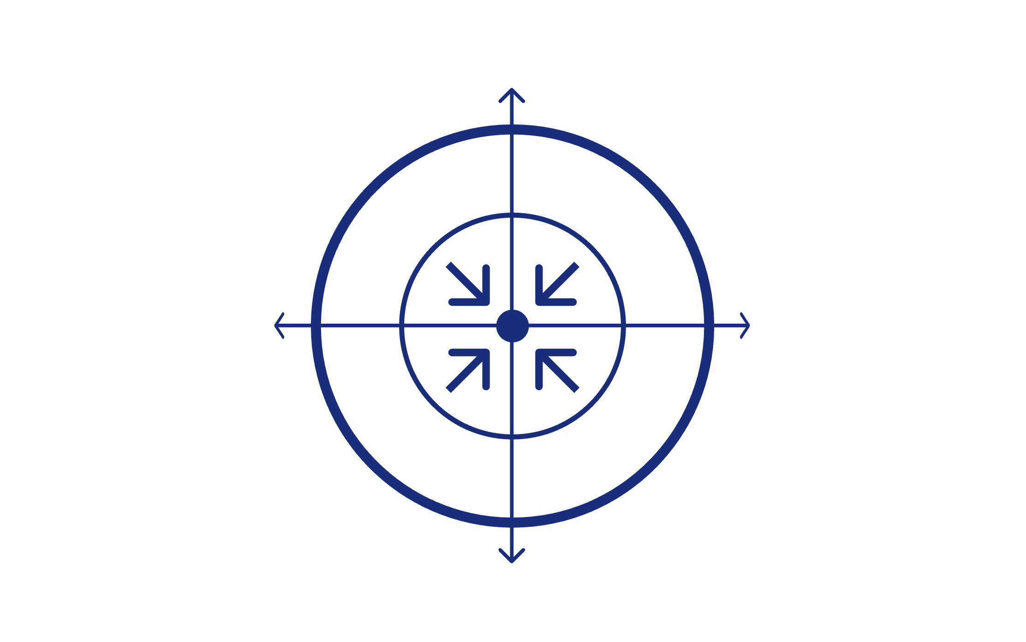
Routing Setup & Navigation
BrowserRouter
Key Concepts
Dynamic Routes with Params
Use :id in route paths and useParams() to read values — essential for detail pages and resource-based URLs.
Link / NavLink
Routes
Nested Routes
Compose layouts with child routes using <Outlet />. Keep shared UI (navbars, sidebars) in parent route components.
Redirects
Use useNavigate() for programmatic navigation — redirect after form submission, auth checks, or 404 fallbacks.
Route
Declarative routing keeps navigation logic co-located with component structure, making large apps easier to reason about.

Slide 8
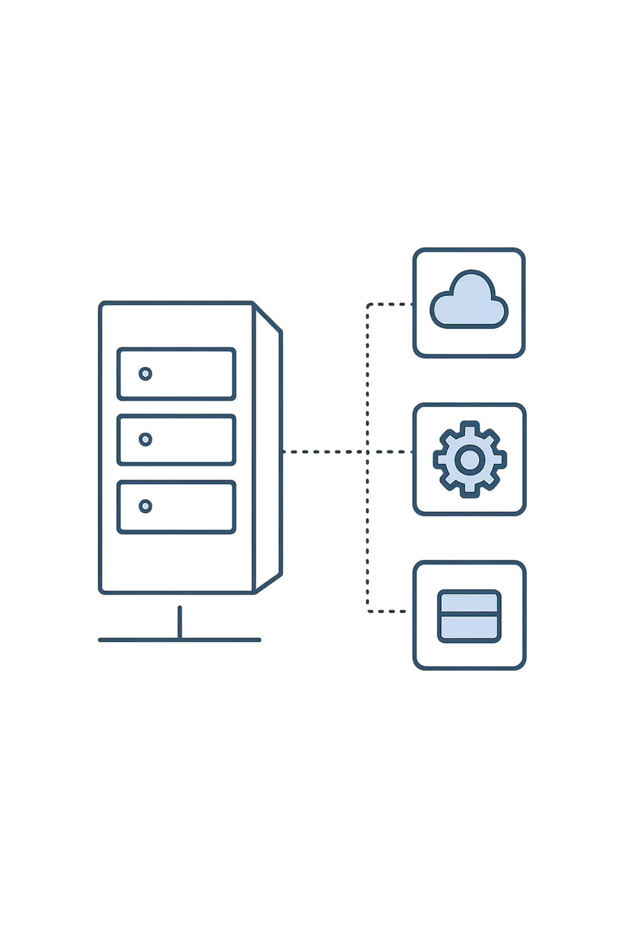
CHAPTER 3
API Integration & Storage
Connect your React frontend to real data — fetch from APIs, persist state in the browser, and architect reusable data service layers.

Slide 9
Fetch, Axios & Custom Services
Browser Storage
Fetch API
Axios
Built-in browser API for HTTP requests. Pair with async/await and handle errors explicitly — fetch only rejects on network failure, not HTTP errors.
A popular HTTP client with automatic JSON parsing, request/response interceptors, and cleaner error handling out of the box.
Local Storage
Persistent across sessions. Best for user preferences and tokens.
Session Storage
Cleared on tab close. Ideal for temporary UI state or wizard steps.
Custom Service Layer
Abstract API calls into dedicated service files (e.g. userService.js). Keeps components clean and makes swapping backends trivial.
Cookies
Sent with every HTTP request. Use for auth tokens with HttpOnly and Secure flags for security.

Slide 10


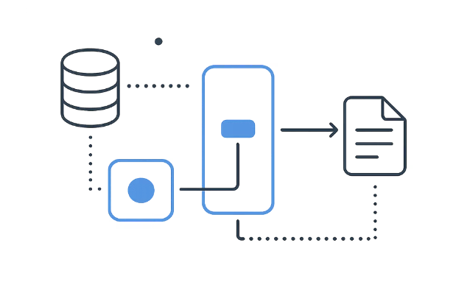
Day 2 — What You'll Build
Dynamic Form UI
Multi-Page Application
API-Connected Frontend
A controlled multi-field form with real-time validation, error feedback, and conditional submit logic using React event handling and lifecycle hooks.
A React Router-powered app with dynamic routes, nested layouts, and programmatic navigation — structured for real-world scale.
Fetch data from a mock API using Axios and custom services, then persist relevant state to local storage — a full frontend data layer.

